Slide 1


Datalog Repair guided by CTL Properties
22 Nov 2023 @ APR Event
Yu Liu, Yahui Song, Martin Mirchev,
Sergey Mechtaev, Abhik Roychoudhury

Slide 2
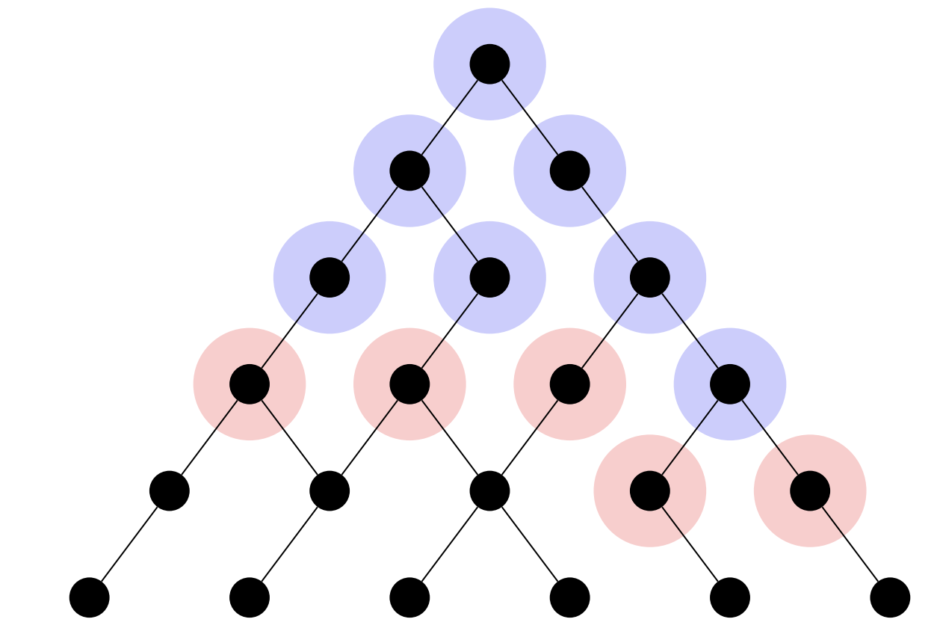
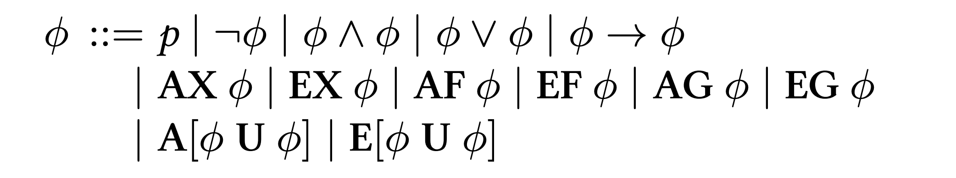
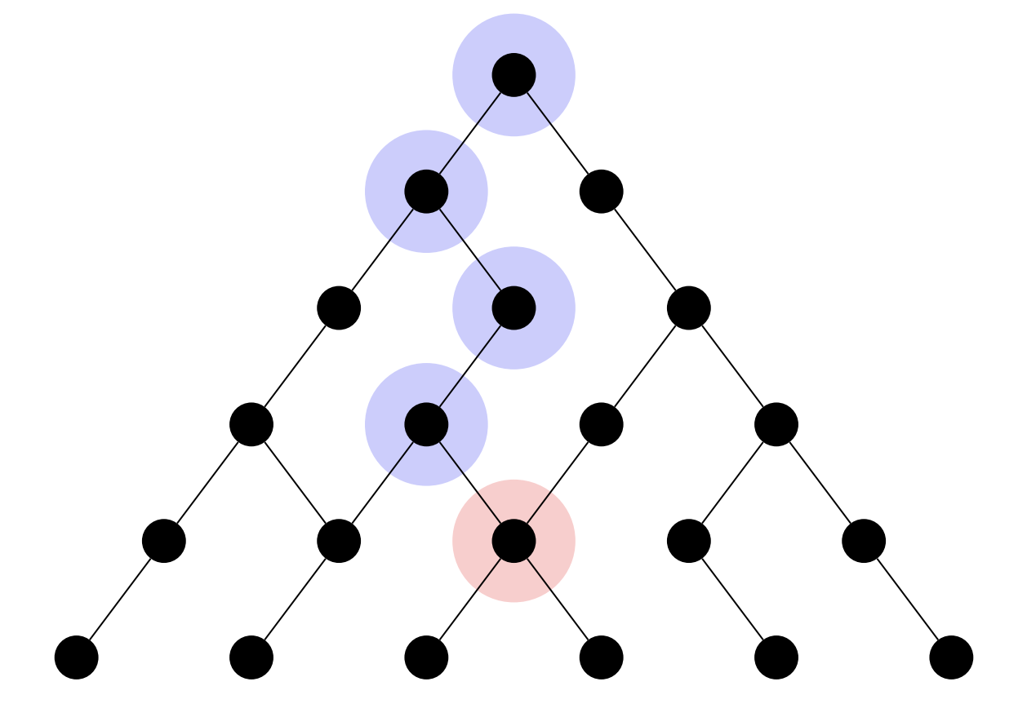
Computational Tree Logic
Branching-time logic:
Goals:
- a more precise analysis for CTL properties in real code
- automated repair when CTL violations occur
A [ blue U red ]
E [ blue U red ]

Slide 3
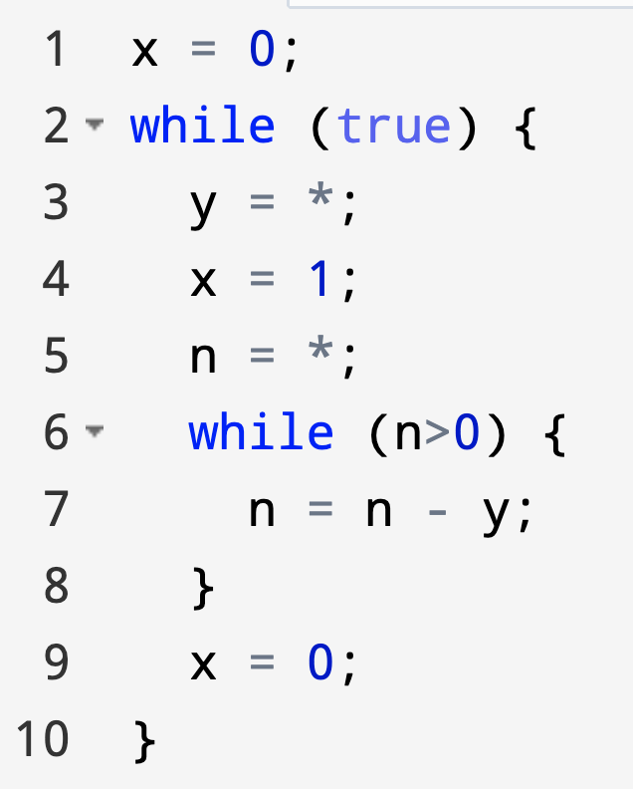


CTL Properties and Violations (1)
“Whenever x = 1, then eventually x = 0.”
In CTL we would express as:
EG(x=1 ⇒ AF(x=0))
If we restrict the nondeterministic choice at line 3
To be y >= 1, the the following holds as well.
AG(x=1 ⇒ AF(x=0))
Example modified from “Reasoning about Nondeterminism in Programs” PLDI 2013
Notes:
The symbol * represents nondeterministic choice. Imagine that we would like to prove that it is possible to maintain the invariant that, whenever x = 1, then eventually x = 0. In CTL we would express this property as:

Slide 4
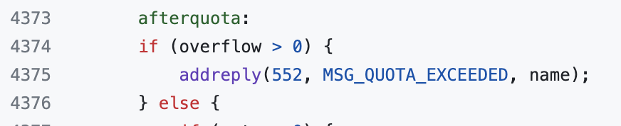
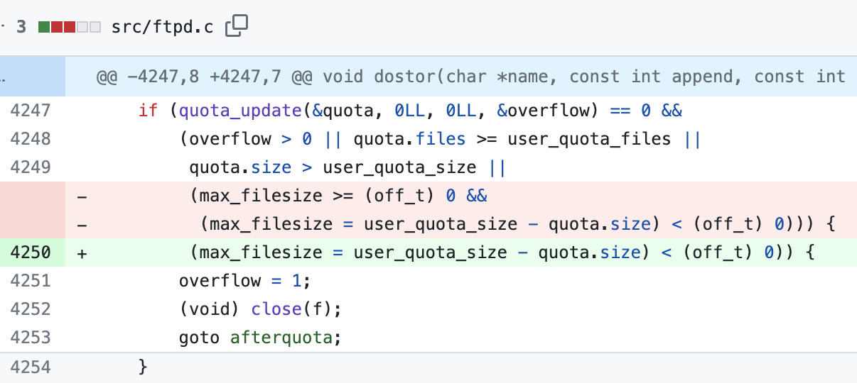
CTL Properties and Violations (2)
Pure-ftpd: “Whenever user quota is exceeded, must finally reply a quota exceed message 552.”
In CTL we would express as:
p = user_quota_size –
quota.size < 0
AG(p ⇒ AX (overflow=1))
AG(overflow=1 ⇒
AF(addreply(552)))
Example modified from “Linear-time Temporal Logic guided Greybox Fuzzing” ICSE 2022
Notes:
The symbol * represents nondeterministic choice. Imagine that we would like to prove that it is possible to maintain the invariant that, whenever x = 1, then eventually x = 0. In CTL we would express this property as:

Slide 5
Existing analyses for CTL
CTL model checking: recursively labeling the states of a finite state machine with the CTL sub-formula.

Slide 6
Existing analyses for CTL
CTL model checking: recursively labeling the states of a finite state machine with the CTL sub-formula.
AF p
AF p
EF p
EF p
AF p
AF p
AF p
EF p
AF p
AF p

Slide 7
Existing analyses for CTL
CTL model checking: recursively labeling the states of a finite state machine with the CTL sub-formula.
Abstract interpretation:
Notes:
The domain cannot represent Parity

Slide 8
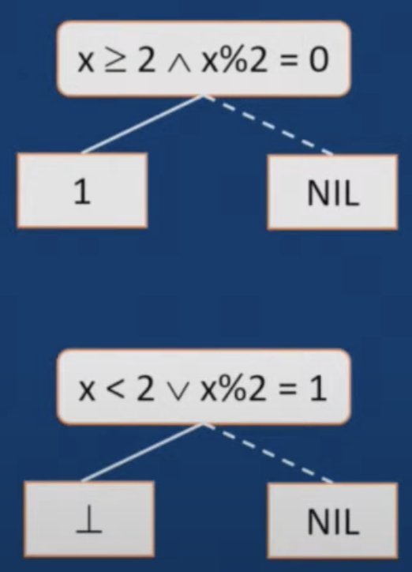
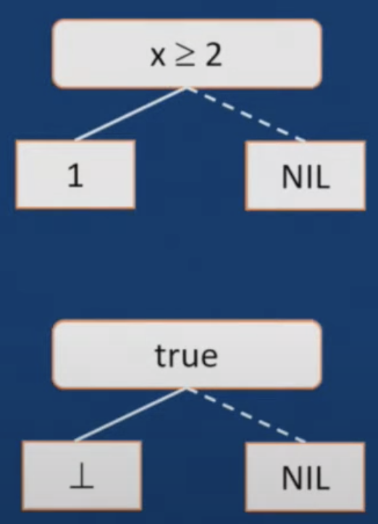
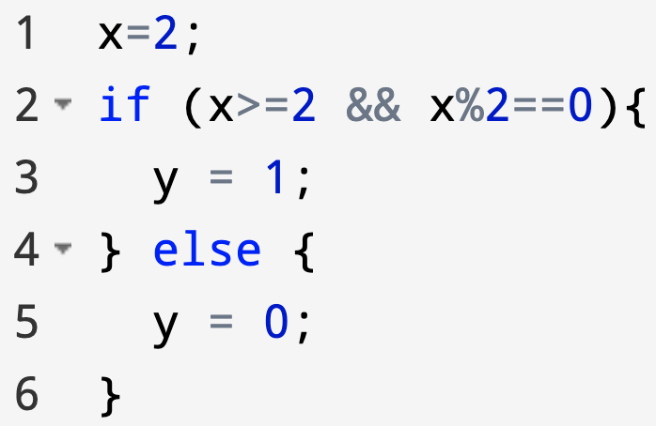
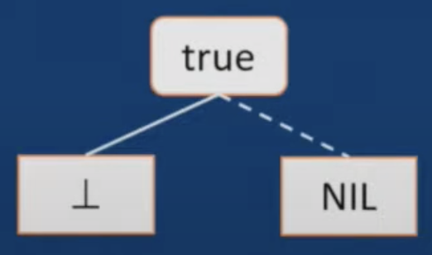
Abstract Interpretation of CTL Properties [SAS2019]
backwards reasoning, to infer precondition and
handle A/E quantifiers via approximations
AF(y=1)
Over
Approx.
Examples modified from the talk “SAS2018 - Abstract Interpretation of CTL Properties (by Peter Müller)”
Over approximation when
it’s universal quantifiers
Notes:
The domain cannot represent Parity
map each point to a function over-approximating concrete semantics, and the analysis is performed backward for each CTL sub-formula.

Slide 9
Abstract Interpretation of CTL Properties [SAS2019]
backwards reasoning, to infer precondition and
handle A/E quantifiers via approximations
EF(y=1)
false
Under
Approx.
x < 2
Examples modified from the talk “SAS2018 - Abstract Interpretation of CTL Properties (by Peter Müller)”
Over approximation when
it’s universal quantifiers
Notes:
The domain cannot represent Parity
map each point to a function over-approximating concrete semantics, and the analysis is performed backward for each CTL sub-formula.

Slide 10
Existing analyses for CTL
CTL model checking: recursively labeling the states of a finite state machine with the CTL sub-formula.
Abstract interpretation: backward reasoning,
over-approximation for universal properties, and
under-approximation for existential properties.
Question: how to achieve a more precise CTL analysis for real code?
Notes:
The domain cannot represent Parity

Slide 11
CTL analysis: Datalog with Stratified Negation
EF p
AF p
efp(X) :- p(X).
efp(X) :- flow(X, Y), efp(Y).
T(X,Y) :- !P(X), flow(X, Y).
T(X,Z) :- T(X,Y), !P(Y), flow(Y, Z).
S(X) :- T(X, X).
S(X) :- !P(X), flow(X, Y), S(Y).
afp(X) :- !S(X).
AG p = !EF(!p)
efNP(X) :- !p(X).
efNP(X) :- flow(X, Y), efNP(Y).
agp(X) :- ! efNP(X).
Encodings for AF is taken from “Datalog LITE: a deductive query language with linear time model checking” 2002.
Notes:
In general every CTL operator has a fixed point characterization which provides a recursive encoding. The Datalog rules will roughly encode this fixed point characterization
- we may not be able to claim full novelty about using Datalog to capture temporal property satisfaction - see this paper
https://link.springer.com/content/pdf/10.1007/3-540-63166-6_16.pdf
TODO

Slide 12
“Programs are databases”
assign("x", 2, 1).
assign("y", 1, 3).
assign("y", 0, 5).
flow (1, 2).
flow (2, 3) :- GTEQ("x", 2, 2), Even("x", 2).
flow (2, 5) :- ! GTEQ("x", 2, 2).
flow (2, 5) :- ! Even("x", 2).
flow (3, 6).
flow (5, 6).
AF(y=1)
Notes:
GTEQ and Even are propagated.

Slide 13
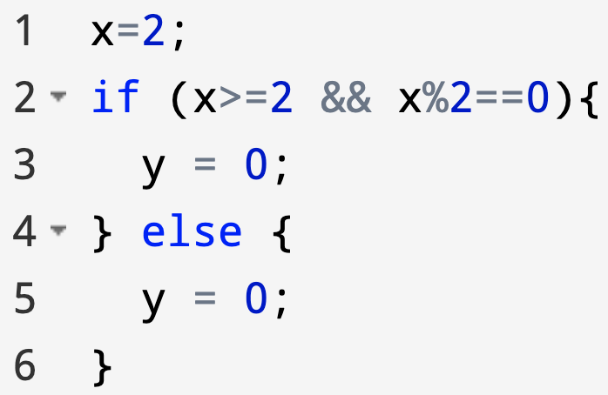
“Programs are databases”
assign("x", 2, 1).
assign("y", 0, 3).
assign("y", 0, 5).
flow (1, 2).
flow (2, 3) :- GTEQ("x", 2, 2), Even("x", 2).
flow (2, 5) :- ! GTEQ("x", 2, 2).
flow (2, 5) :- ! Even("x", 2).
flow (3, 6).
flow (5, 6).
AF(y=1)
Notes:
GTEQ and Even are propagated.

Slide 14
Goals: a more precise analysis for CTL properties in real code
automated repair when CTL violations occur

Slide 15

Prior work
Bug types: Java NPE bugs, Python data leaks, Solidity smart contracts bugs
Limitation: rules are positive, i.e., no negative body atoms.
Notes:
Delta debugging, require monotonicity.
Over-approximation to make all the negative facts into positive facts.

Slide 16
CTL analysis: Datalog with Stratified Negation
AG(x=1 ⇒ AF(x=0))
transFlow(x,y) :- flow(x,y).
transFlow(x,z) :- flow(x,y), transflow(y,z).
xIsValue_0(loc,x) :- state(loc), (x == 0).
AF_xIsValue_0_T(__state_extra,loc,x) :- AF_xIsValue_0_T(tempOne,loc,x), !xIsValue_0(tempOne,x), flow(tempOne,__state_extra).
AF_xIsValue_0_T(__state_extra,loc,x) :- !xIsValue_0(loc,x), flow(loc,__state_extra).
AF_xIsValue_0_S(loc,x) :- !xIsValue_0(loc,x), flow(loc,tempOne), AF_xIsValue_0_S(tempOne,x).
AF_xIsValue_0_S(loc,x) :- AF_xIsValue_0_T(loc,loc,x).
AF_xIsValue_0(loc,x) :- state(loc), !AF_xIsValue_0_S(loc,x).
xIsValue_1(loc,x) :- state(loc), (x == 1).
xIsValue_1_IMPLY_AF_xIsValue_0(loc,x) :- !xIsValue_1(loc,x).
xIsValue_1_IMPLY_AF_xIsValue_0(loc,x) :- AF_xIsValue_0(loc,x).
NOT_xIsValue_1_IMPLY_AF_xIsValue_0(loc,x) :- state(loc), !xIsValue_1_IMPLY_AF_xIsValue_0(loc,x).
EF_NOT_xIsValue_1_IMPLY_AF_xIsValue_0(loc,x) :- flow(loc,tempOne), EF_NOT_xIsValue_1_IMPLY_AF_xIsValue_0(tempOne,x).
EF_NOT_xIsValue_1_IMPLY_AF_xIsValue_0(loc,x) :- NOT_xIsValue_1_IMPLY_AF_xIsValue_0(loc,x).
AG_xIsValue_1_IMPLY_AF_xIsValue_0(loc,x) :- state(loc), !EF_NOT_xIsValue_1_IMPLY_AF_xIsValue_0(loc,x).
Notes:
In general every CTL operator has a fixed point characterization which provides a recursive encoding. The Datalog rules will roughly encode this fixed point characterization
- we may not be able to claim full novelty about using Datalog to capture temporal property satisfaction - see this paper
https://link.springer.com/content/pdf/10.1007/3-540-63166-6_16.pdf
TODO

Slide 17
Automated Repair via symbolic Datalog Execution
AF(y=1)
assign("x", 2, 1).
assign(“y”, 0, 3).
assign("y", 0, 5).
flow (1, 2).
flow (2, 3) :- GTEQ("x", 2, 2), Even("x", 2).
flow (2, 5) :- ! GTEQ("x", 2, 2).
flow (2, 5) :- ! Even("x", 2).
flow (3, 6).
flow (5, 6).
assign(“y”, 1, 3).
y_is_1(X) :- assign("y", 1, X).
T(X,Y) :- !y_is_1(X), flow(X, Y).
T(X,Z) :- T(X,Y), !y_is_1(Y), flow(Y, Z).
S(X) :- T(X, X).
S(X) :- !y_is_1(X), End(X).
S(X) :- !y_is_1(X), flow(X, Y), S(Y).
af_y_is_1(X) :- State(X), !S(X).
Notes:
GTEQ and Even are propagated.
af_y_is_1
===============
===============

Slide 18
Summary
Thank you for your attention!
a more precise CTL property analysis.
Fact generation from the source code.
Encoding arithmetic/termination constraints via Datalog rules.
A Datalog-based program repair which support negative rules.
Approximating negative atoms via positive atoms.
Eliminating the contradictory patches for precision: if there exits a patch, it will make the violation disappear.

Slide 20
Oct 31 APR meeting (CTL-Datalog)
The motivation: many CTL property violations need to be fixed (automatic analysis + repair).
Main Novelty: Datalog-based repair which supports negations (Liu Yu).
Why choose Datalog: the CTL property analysis using the Datalog engine is concise and elegant.
In general, every CTL operator has a fixed-point characterization which provides a recursive encoding.
The Datalog rules will roughly encode this fixed-point characterization.
Technical difficulties: how to encode AF operator.
Technical contribution (for the analysis): generating facts for the CTL property analysis hasn't been done yet, and we propose a solution.
Technical difficulties: how to encode facts relating to the termination and arithmetic constraints?
These facts are needed because whether CTL properties hold highly depends on the loop termination and path constraints.

Slide 23
Datalog Repair guided by CTL Properties

Slide 24
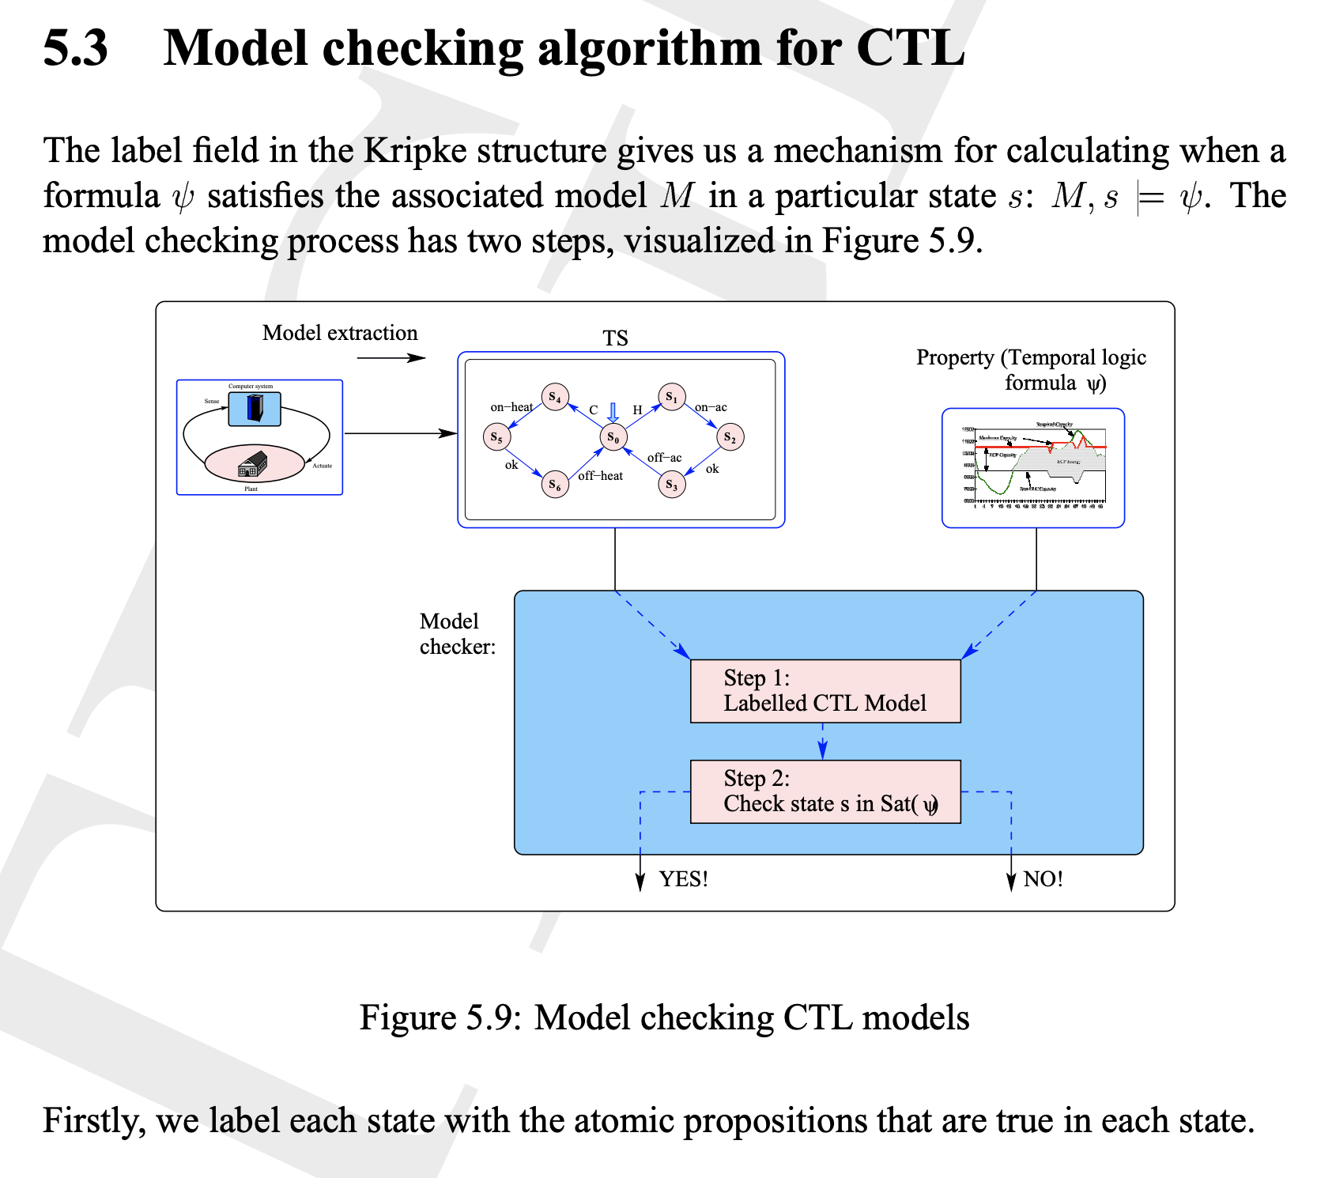
Notes:
https://www.comp.nus.edu.sg/~cs5270/Notes/chapt5.pdf

Slide 25
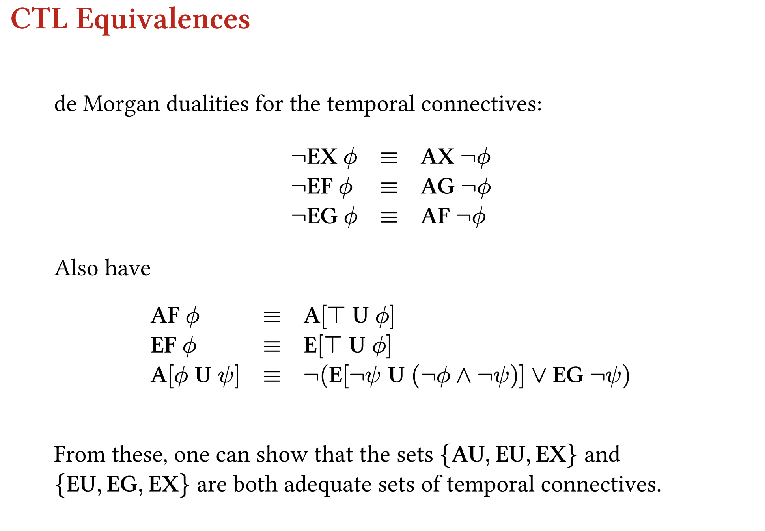
Notes:
https://www.inf.ed.ac.uk/teaching/courses/fv/slides/slides05.pdf

Slide 26
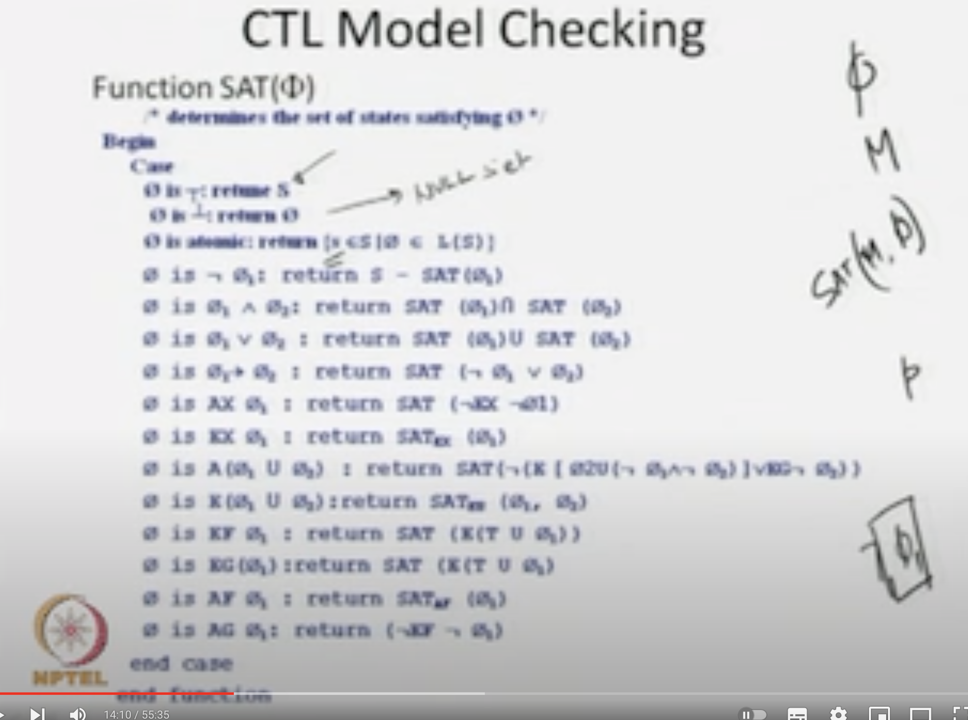
Notes:
https://www.youtube.com/watch?v=a-Xerqadt6I

Slide 27
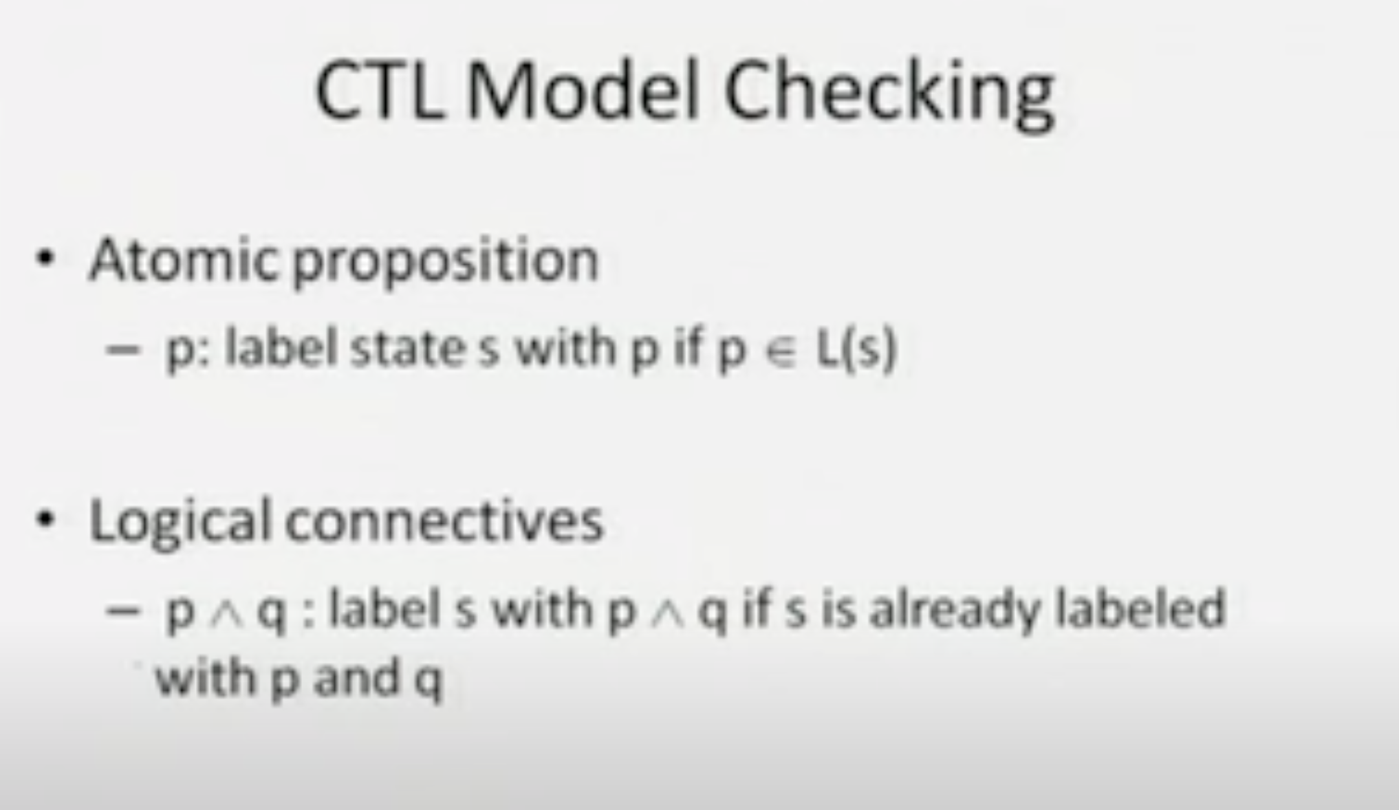
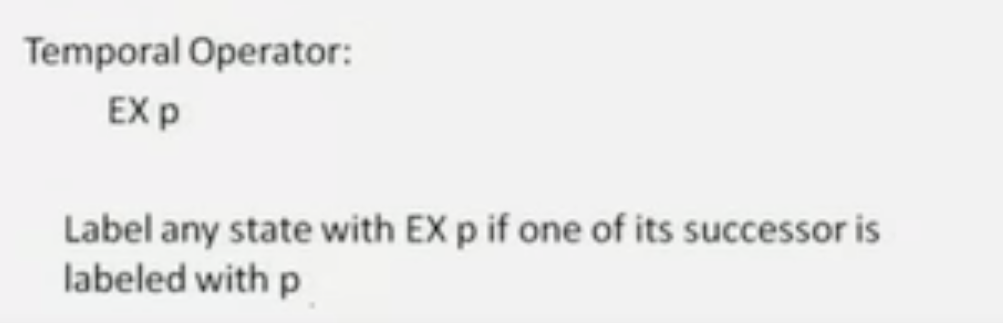

Slide 28
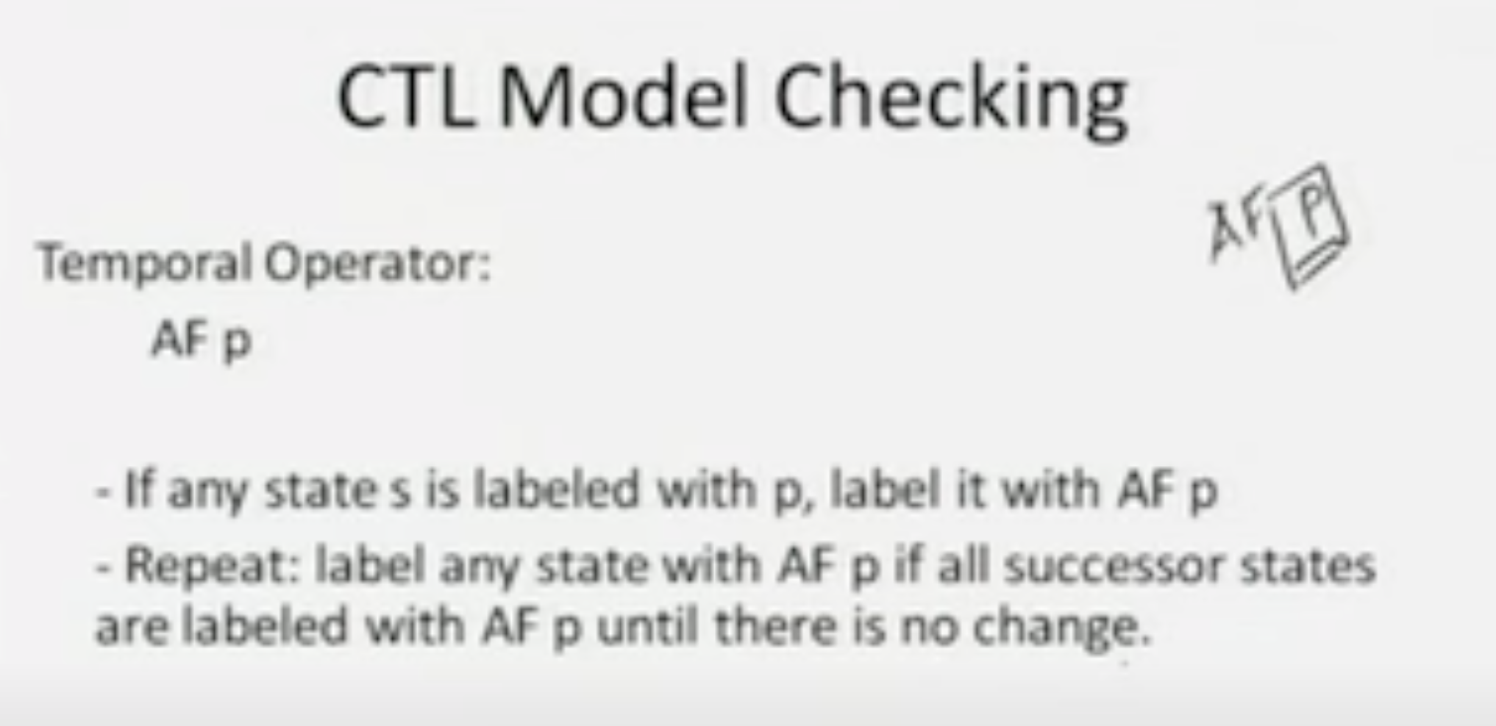
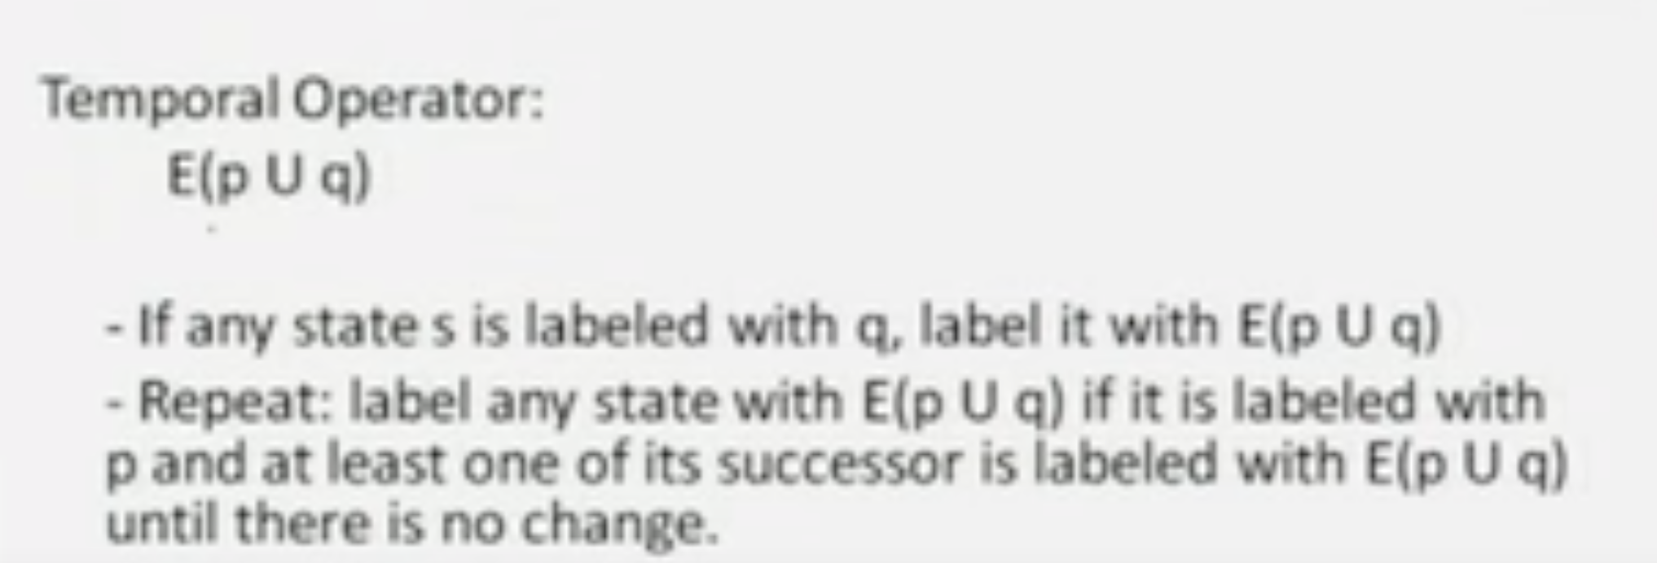
Afp = p \/ AXAFp

Slide 29
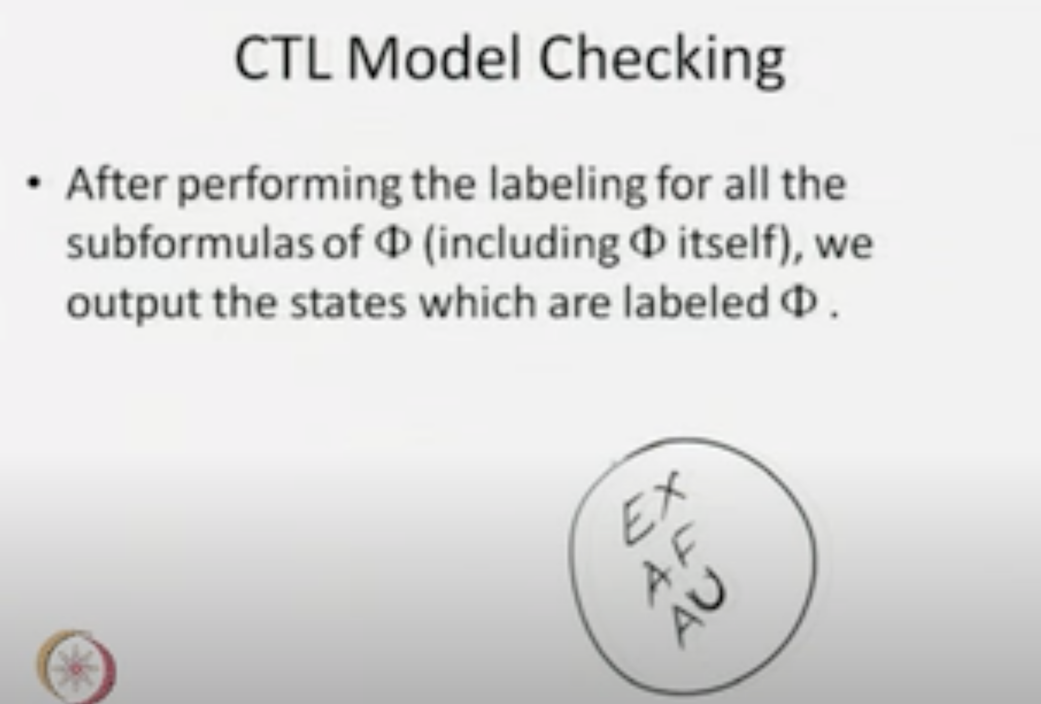

Slide 30
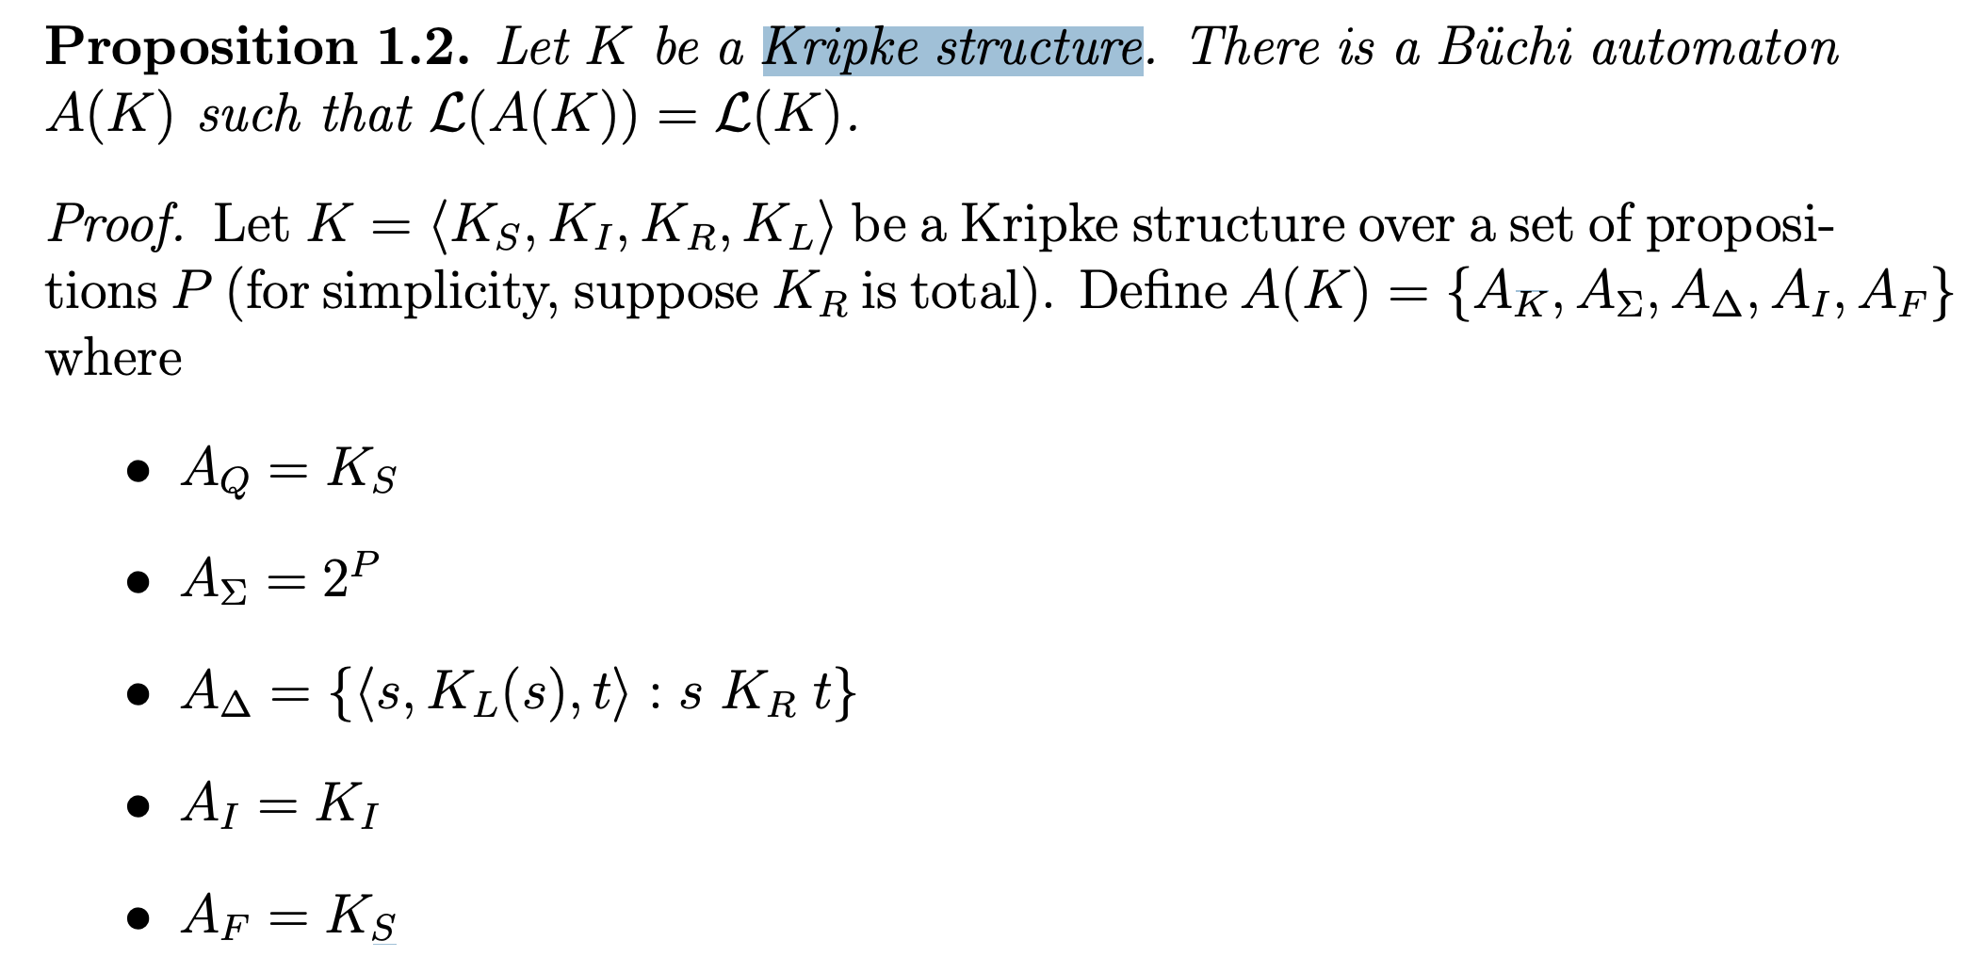
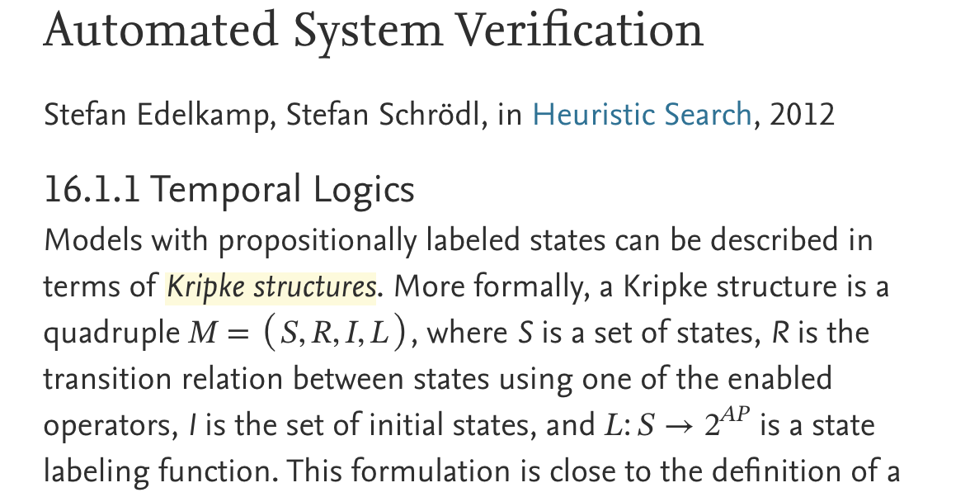
Notes:
https://www.sciencedirect.com/topics/computer-science/kripke-structure

Slide 31
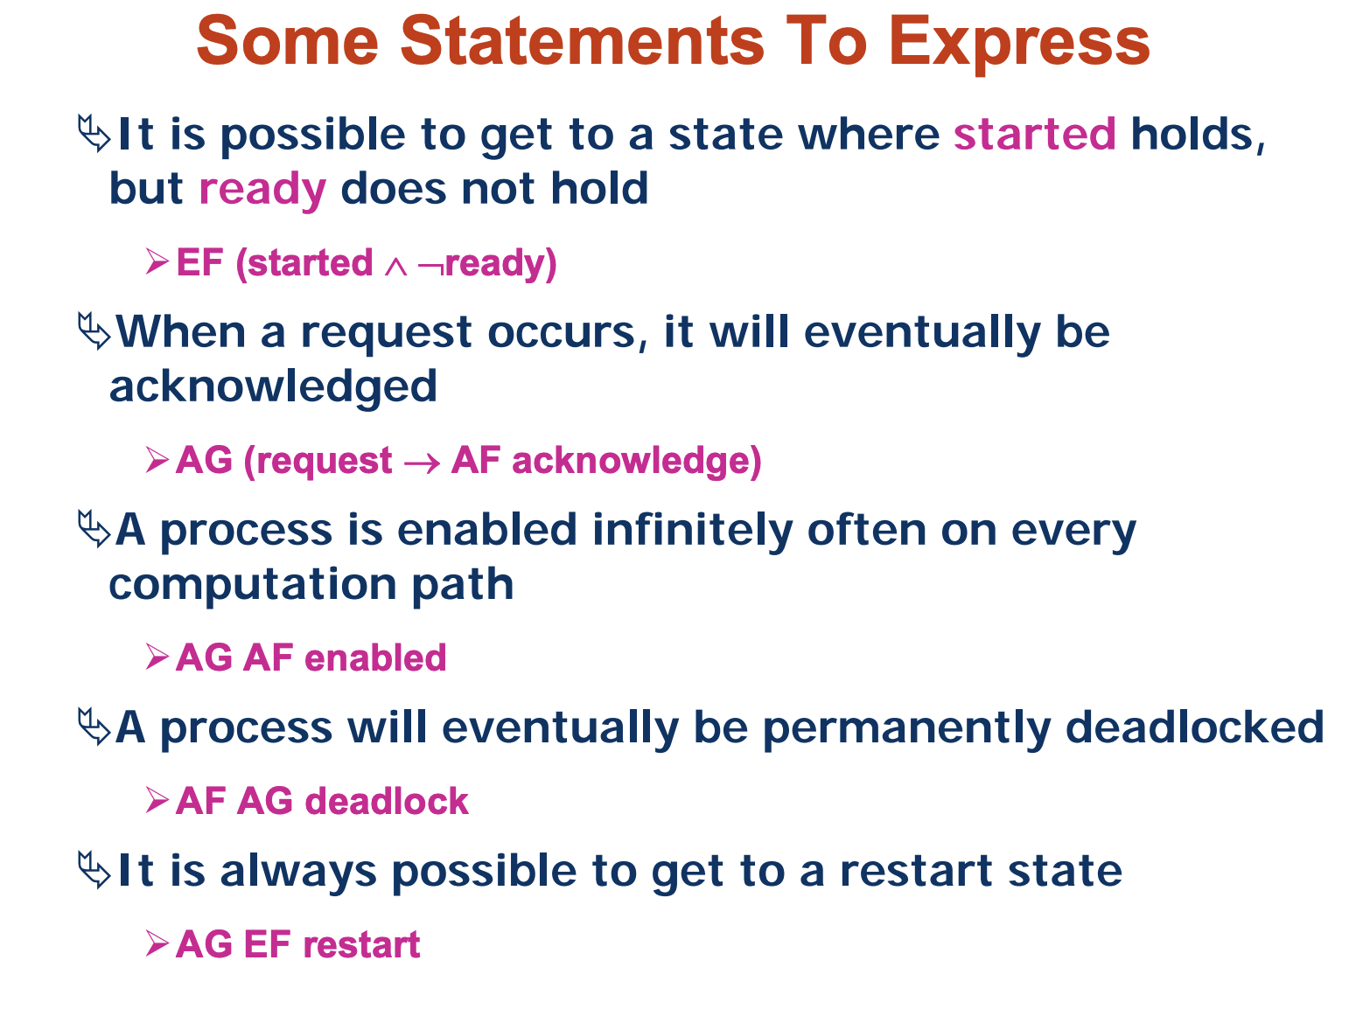

Slide 32
Datalog – CTL properties Analysis & Repair
-- A blueprint of this project
For the meeting on 14th July 2023

Slide 33
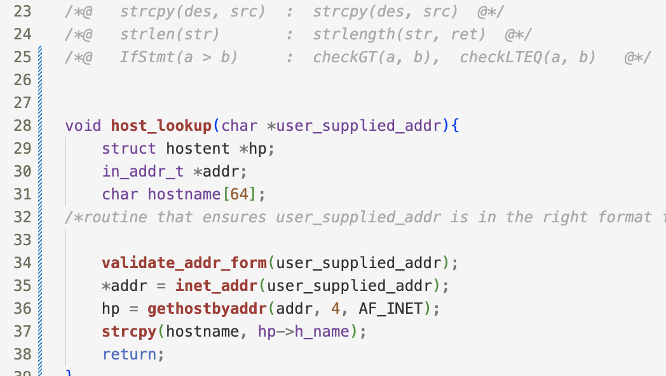
CWE-121: Stack-based Buffer Overflow
https://cwe.mitre.org/data/definitions/121.html
Facts Generation Schema
Possible Buggy Code

Slide 34
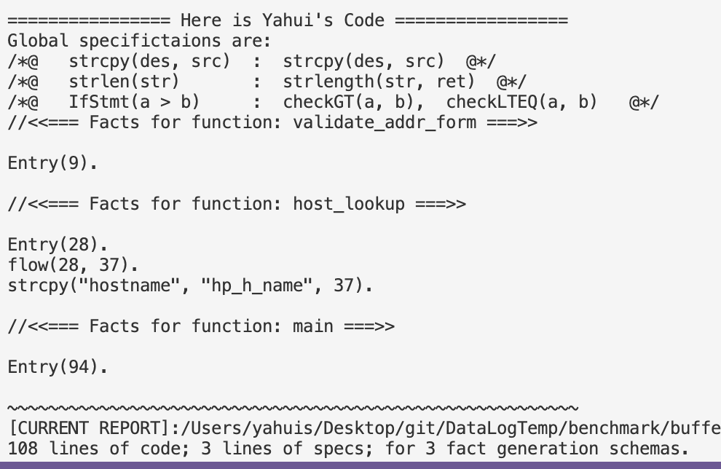

CWE-121: Stack-based Buffer Overflow
https://cwe.mitre.org/data/definitions/121.html

Slide 35
Datalog Rules for Buffer Overflow
NotBuffer_Overflow(des, src, l3) :- strcpy(des, src, l3),
transFlow(l2, l3), checkGT(a, b, l2), strlength(des, a, _),strlength(src, b, _),
transFlow(l1, l2), Entry (l1).
Buffer_Overflow (des, src, l) :- strcpy(des, src, l), ! NotBuffer_Overflow(des, src, l).
FinallyBuffer_Overflow (x) :- Buffer_Overflow (_, _, x).
FinallyBuffer_Overflow (x) :- transFlow(x, loc), Buffer_Overflow (_, _, loc).
AG_NotBuffer_Overflow(x) :- Entry(x), ! FinallyBuffer_Overflow(x).
Rules with Temporal Operators can
be generated automatically !
Query: AG(NotBuffer_Overflow)

Slide 36
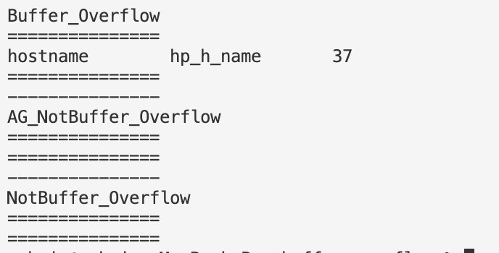
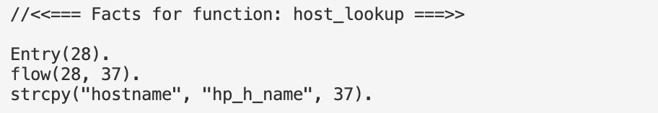
Test it out!

Slide 37
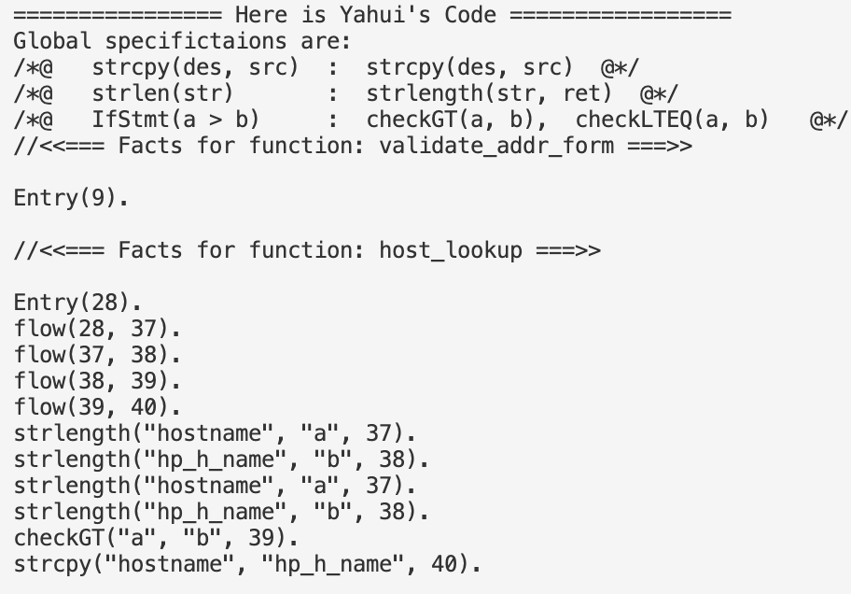
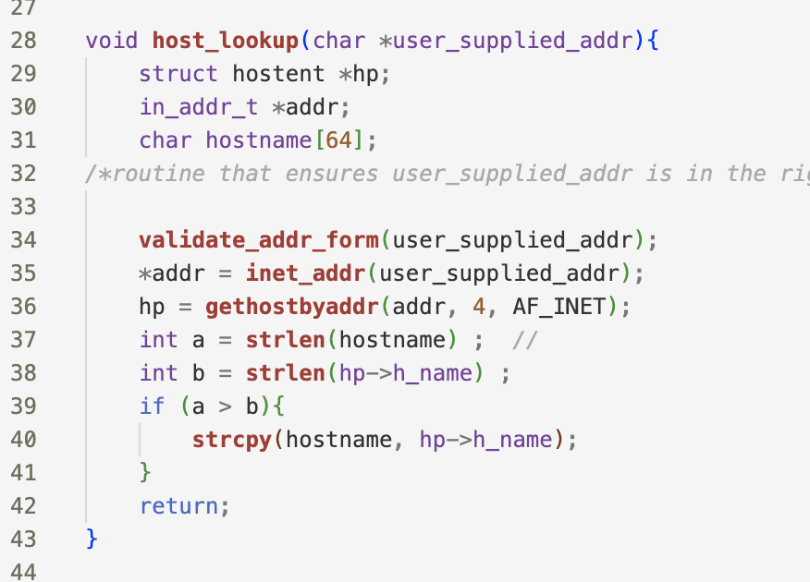
Correct Case

Slide 38
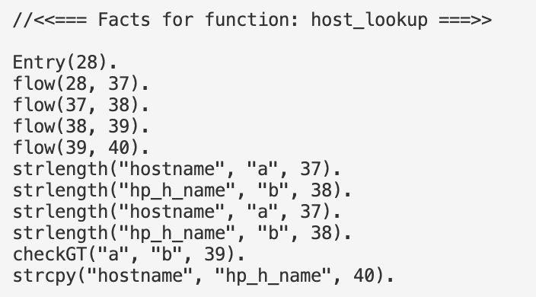
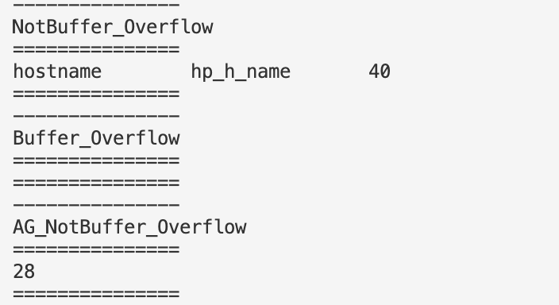
Test it out!

Slide 39
Test it out!
The repair work

Slide 40
The repair work
NotBuffer_Overflow(des, src, l3) :- strcpy(des, src, l3),
transFlow(l2, l3), checkGT(a, b, l2), strlength(des, a, _),strlength(src, b, _),
transFlow(l1, l2), Entry (l1).
Buffer_Overflow (des, src, l) :- strcpy(des, src, l), ! NotBuffer_Overflow(des, src, l).
FinallyBuffer_Overflow (x) :- Buffer_Overflow (_, _, x).
FinallyBuffer_Overflow (x) :- transFlow(x, loc), Buffer_Overflow (_, _, loc).
AG_NotBuffer_Overflow(x) :- Entry(x), ! FinallyBuffer_Overflow(x).
Target is + AG_NotBuffer_Overflow(28)
➔ - FinallyBuffer_Overflow(28)

Slide 41
The repair work
NotBuffer_Overflow(des, src, l3) :- strcpy(des, src, l3),
transFlow(l2, l3), checkGT(a, b, l2), strlength(des, a, _),strlength(src, b, _),
transFlow(l1, l2), Entry (l1).
Buffer_Overflow (des, src, l) :- strcpy(des, src, l), ! NotBuffer_Overflow(des, src, l).
FinallyBuffer_Overflow (x) :- Buffer_Overflow (_, _, x).
FinallyBuffer_Overflow (x) :- transFlow(x, loc), Buffer_Overflow (_, _, loc).
AG_NotBuffer_Overflow(x) :- Entry(x), ! FinallyBuffer_Overflow(x).
Target is + AG_NotBuffer_Overflow(28)
- FinallyBuffer_Overflow(28)
➔ - Buffer_Overflow (_, _, 37)

Slide 42
The repair work
NotBuffer_Overflow(des, src, l3) :- strcpy(des, src, l3),
transFlow(l2, l3), checkGT(a, b, l2), strlength(des, a, _),strlength(src, b, _),
transFlow(l1, l2), Entry (l1).
Buffer_Overflow (des, src, l) :- strcpy(des, src, l), ! NotBuffer_Overflow(des, src, l).
FinallyBuffer_Overflow (x) :- Buffer_Overflow (_, _, x).
FinallyBuffer_Overflow (x) :- transFlow(x, loc), Buffer_Overflow (_, _, loc).
AG_NotBuffer_Overflow(x) :- Entry(x), ! FinallyBuffer_Overflow(x).
Target is + AG_NotBuffer_Overflow(28)
- FinallyBuffer_Overflow(28)
- Buffer_Overflow (_, _, 37)
➔ + NotBuffer_Overflow(_, _, 37)

Slide 43
The repair work
Will this be able to be handled by the existing work?
NotBuffer_Overflow(des, src, l3) :- strcpy(des, src, l3),
transFlow(l2, l3), checkGT(a, b, l2), strlength(des, a, _),strlength(src, b, _),
transFlow(l1, l2), Entry (l1).
Buffer_Overflow (des, src, l) :- strcpy(des, src, l), ! NotBuffer_Overflow(des, src, l).
FinallyBuffer_Overflow (x) :- Buffer_Overflow (_, _, x).
FinallyBuffer_Overflow (x) :- transFlow(x, loc), Buffer_Overflow (_, _, loc).
AG_NotBuffer_Overflow(x) :- Entry(x), ! FinallyBuffer_Overflow(x).
Target is + AG_NotBuffer_Overflow(28)
- FinallyBuffer_Overflow(28)
- Buffer_Overflow (_, _, 37)
➔ + NotBuffer_Overflow(_, _, 37)
Notes:
AG(p => AF q)
AGEF p
afp(S):- findall(trans(S, T), Tlist), all_afp(Tlist).
not_afp(S) :- np(S), trans(S,T), not_afp(T).
# reach from a to b without p
nfp(a, a) :- not p(a)
nfp(a, b) :- not p(b), flow(a,c), nfp(a,c)
afp(a, b) :- not nfp(a, b)

Slide 44
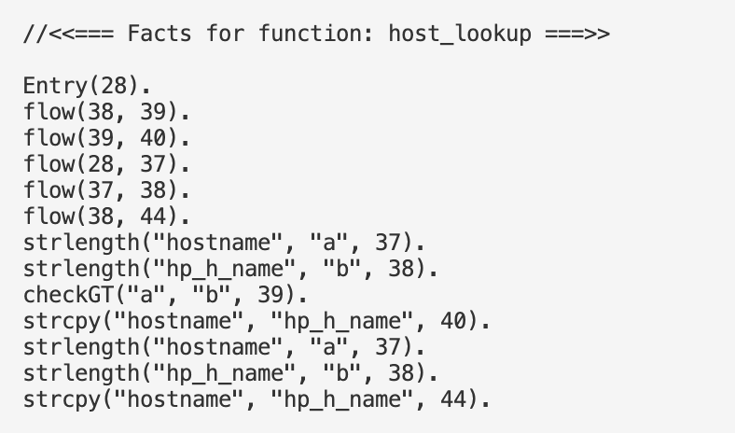
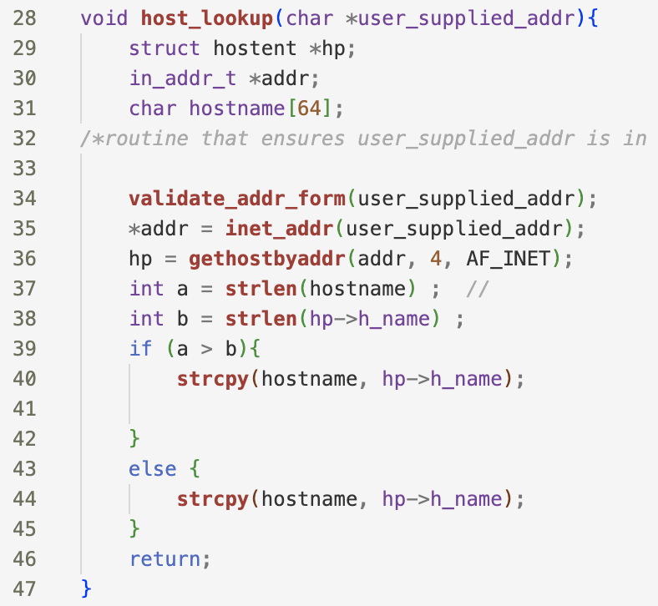
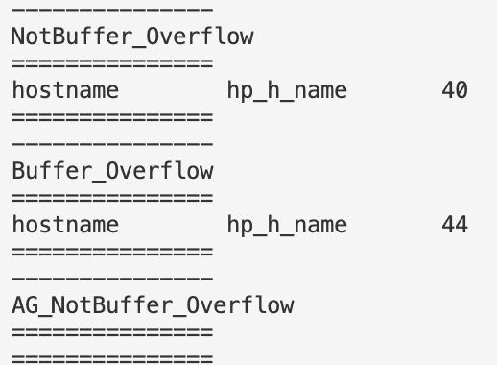
Correct
Buggy

Slide 45
Overview and Workload
User inputs:
F = Fact generation schema
R = Specific reasoning rules
T = Temporal properties queries upon R
E.g., F (R), G (R), AF (R), R1 U R2, AGEF (R) ….
If T failed to hold: Use symbolic execution for Datalog to +/- facts to make T hold.
0. IDB rules propagation to deal with the negations.
1. Translating to meta-program
2. Generate symbolic formulae
3. Constraints generation use delta-debugging
Run Souffle

Slide 46
Overview and Workload
User inputs:
F = Fact generation schema
R = Specific reasoning rules
T = Temporal properties queries upon R
E.g., F (R), G (R), AF (R), R1 U R2, AGEF (R) ….
If T failed to hold: Use symbolic execution for Datalog to +/- facts to make T hold.
0. IDB rules propagation to deal with the negations.
1. Translating to meta-program
2. Generate symbolic formulae
3. Constraints generation use delta-debugging
Run Souffle
Questions:
Related work: Doop, Datalog-based analysis (?), model checking …
Why is that so important to generate facts by ourselves? Less hard-coded complication and more efficient.
<< The last slide >>

Slide 48
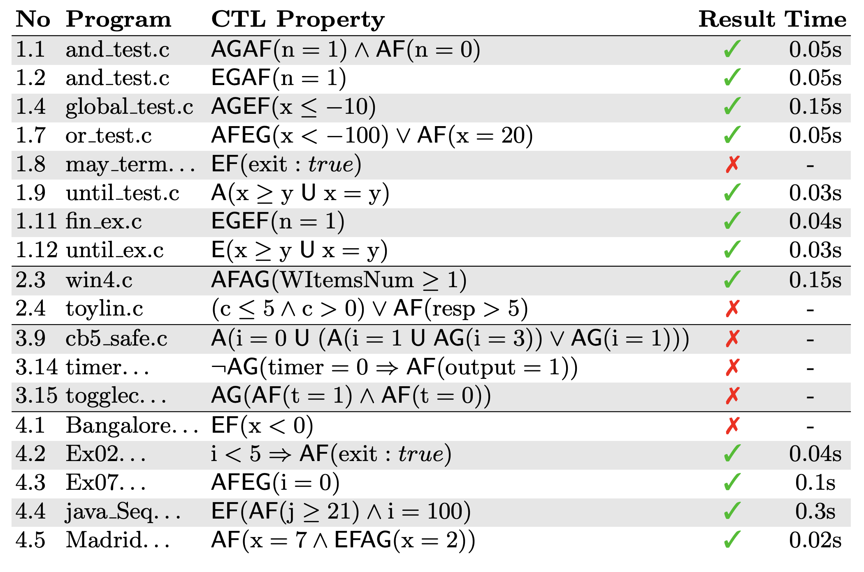
Notes:
https://caterinaurban.github.io/pdf/sas2018.pdf

Slide 49
<<18th July 2023>> Over-approximated Analyses.
Facts
a(1, 2)
c(3)
b(1, 2)
b(2, 3)
b(3, 1)
Z(x) :- a (x, y), ! b(y, z), c(z).
Z’(x) :- a (z, y), neg_b(y, z), c(z).
neg_b(a, y) :- a(x, y), c(z).
domain_x = {1}
domain_y = {2}
domain_z = {3}
#neg_b(y, z) >= # !b (y, z)
#(Z’) >= # (Z)
Notes:
Eliminate all negative atoms from the Datalog programs, then calculate the domains of symbolic constants as usual.

Slide 50
The original workflow
1. Inject symbolic values: constants, signs.
2. Convert to meta programs & compute the symbolic domain
flow (𝐶1 , 2, 𝐶1 , ... , 𝐶𝑛 ) :- domain_alpha_1 (𝐶1), ... , domain_alpha_n (𝐶𝑛 ).
3. Compute the constraints for symbolic signs…delta-debugging

Slide 51
AGEFp
efp(S) :- p(S).
efp(S) :- transition(S, T), efp(T).
n_gefp(S) :- ! efp(S).
n_gefp(S) :- transition(S, T), n_gefp(T).
agefp(S) :- ! n_gefp(S).

Slide 52
AG(p => AF q)
n_fq(S) :- ! q(S).
n_fq(S) :- transition(S, T), n_fq(T).
afq(S) :- ! n_fq(S).
p2afq(S) :- ! p(S).
p2afq(S) :- afq(S). // a => b = (!a \/ b)
n_gp2afq(S) :- ! p2afq(S).
n_gp2afq(S) :- transition(S, T), n_gp2afq(T).
a_gp2afq(S) :- ! n_gp2afq(S).

Slide 53
AG(p => AF q) Souffle accepted code
n_fq(S) :- Entry(S), ! q(S).
n_fq(S) :- transition(S, T), n_fq(T).
afq(S) :- Entry(S), ! n_fq(S).
p2afq(S) :- Entry(S), ! p(S).
p2afq(S) :- afq(S). // a => b = (!a \/ b)
n_gp2afq(S) :- Entry(S), ! p2afq(S).
n_gp2afq(S) :- transition(S, T), n_gp2afq(T).
a_gp2afq(S) :- Entry(S), ! n_gp2afq(S).

Slide 54
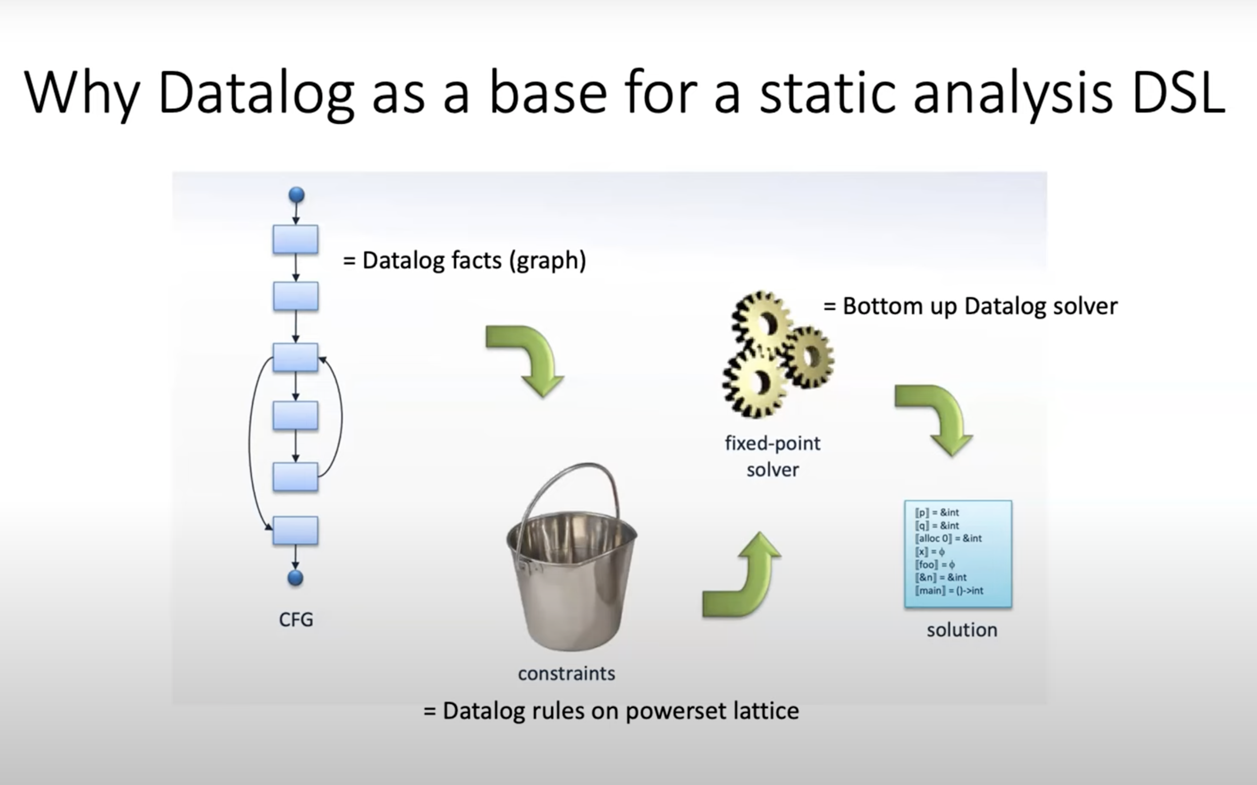
Notes:
https://www.youtube.com/watch?v=mHVIdHLp9ZQ

Slide 55
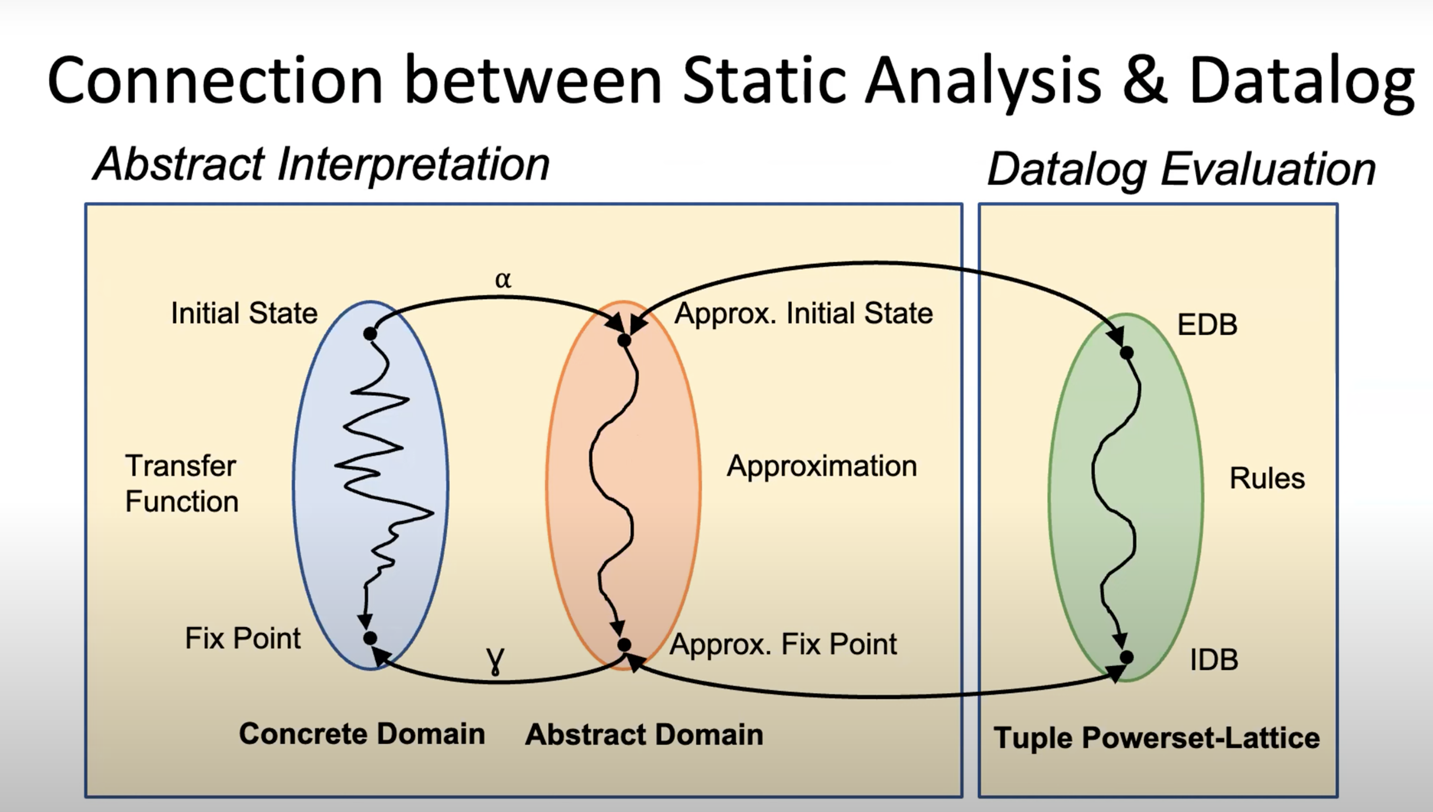

Slide 56
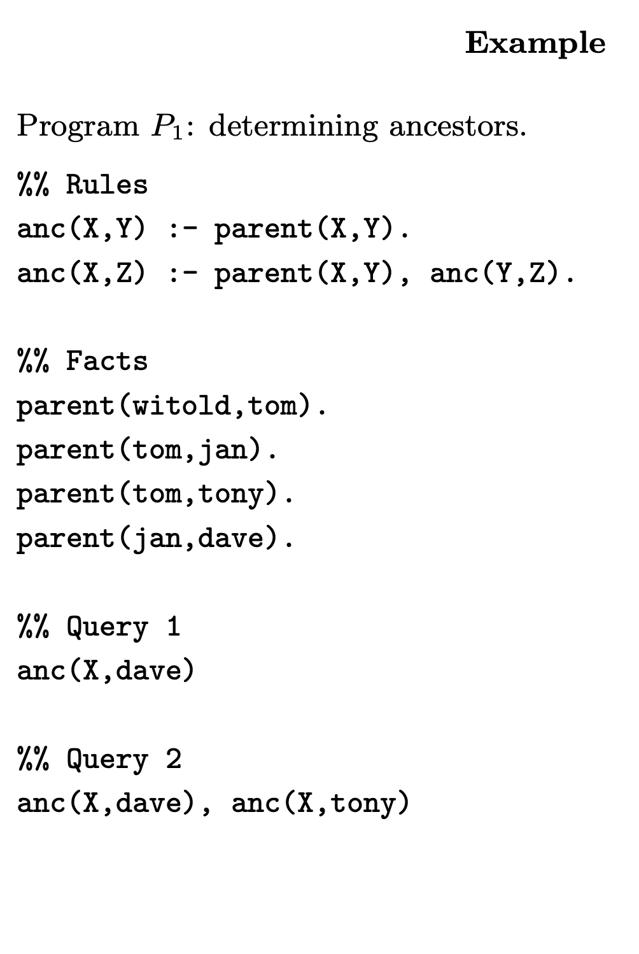
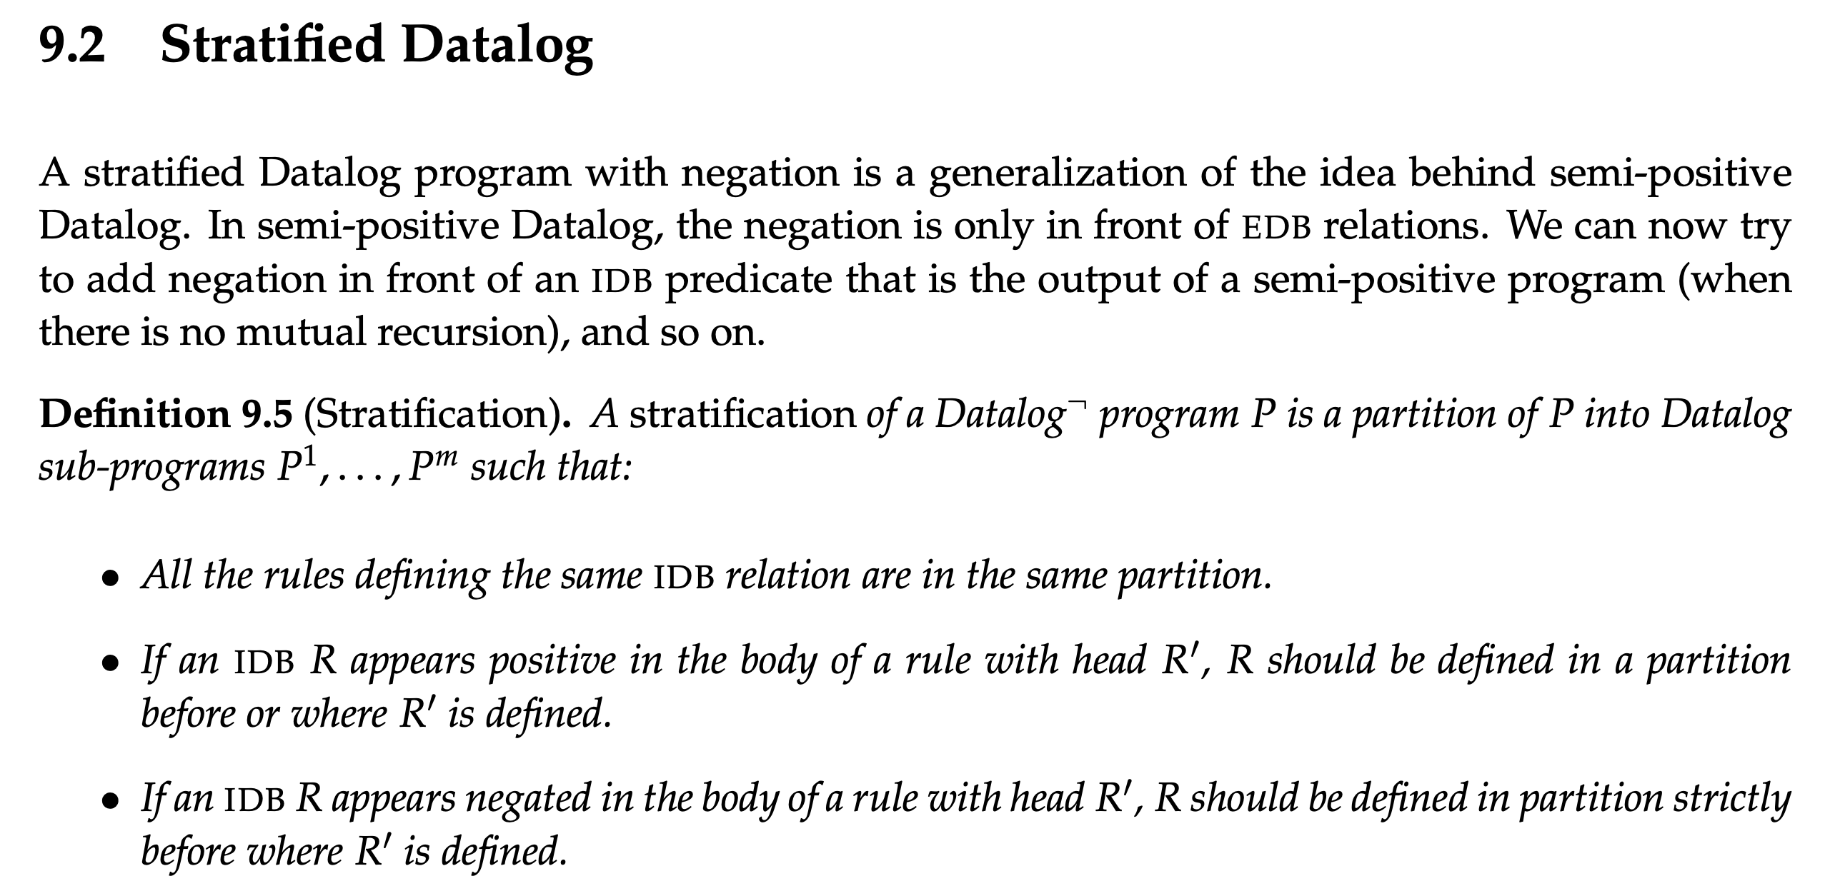
Notes:
https://cse.buffalo.edu/~chomicki/636/datalog-h.pdf
https://pages.cs.wisc.edu/~paris/cs784-s17/lectures/lecture9.pdf

Slide 57
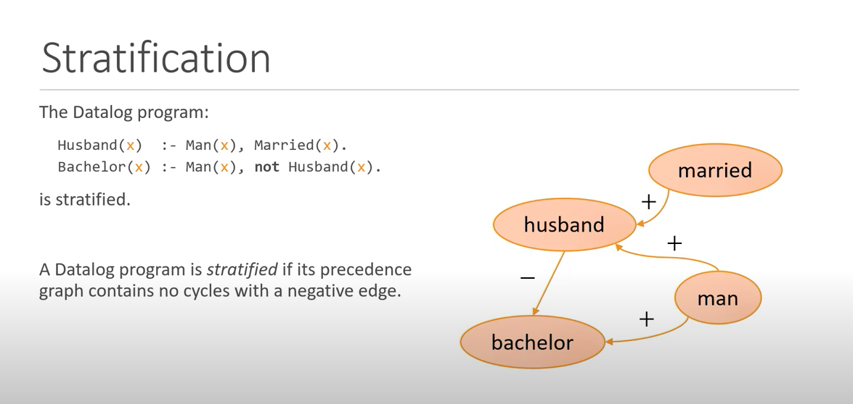
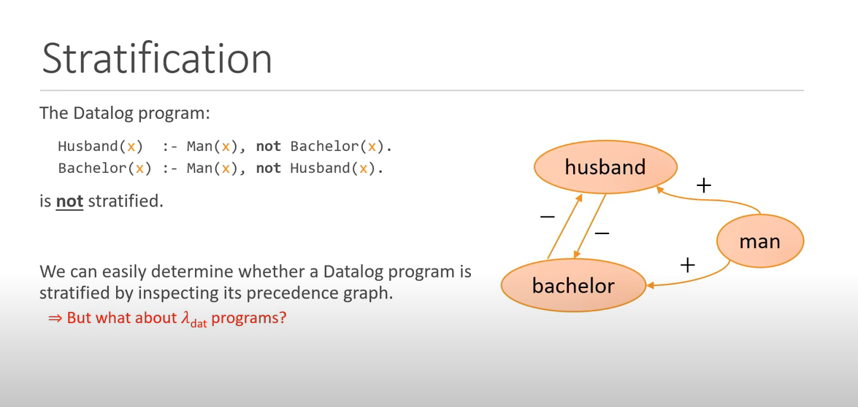
Notes:
Fixpoints for the Masses: Programming with First-Class Datalog Constraints
https://www.youtube.com/watch?v=ikVZrivln8c

Slide 58
branching time temporal logic property AGEFp
The fixed-point semantics of this property will be: gfp X. ( lfp Y.( p OR <-> Y) AND [-] X) agefp(S) :- not n_agefp(S). n_agefp(S) :- not efp(S). n_agefp(S) :- transition(S, T), n_agefp(T). efp(S) :- p(S). efp(S) :- transition(S, T), efp(T).
Forall p = not exist (not p)
agefp(S) :- not n_gefp(S). n_gefp(S) :- n_fp(S). efp(S) :- p(S). efp(S) :- transition(S, T), efp(T).
Notes:
where <-> means there exists an action and [-] means for all actions. In Datalog stratified, you can encode via predicates like
// for all path globally Efp
// exists a path which NOT globally Efp
AGEF -> Recovery problem.
Non starvation

Slide 59
Possible framework
Have user-defined rules for generating propositions as facts
we define a set of rules, as a Datalog library.
Different queries have different repair strategy:
EF(p_bad): to fix till it does not return and results.
What is the difficulty to deal with the stratified negation?

Slide 60
char* strcpy(char* destination, const char* source);
Note: When you use strcpy(), the size of the destination string should be large enough to store the copied string. Otherwise, it may result in undefined behavior.

Slide 61
User inputs:
F = Fact generation schema
R = Specific reasoning rules
T = Temporal properties Queries upon R
E.g., F (R), G (R), AF (R), R1 U R2, AGEF (R) ….
Yahui
If T failed to hold:
Use symbolic execution for Datalog to insert/delete facts to make T hold.
1. Translating to meta-program
2. Generate symbolic formulae
3. Constraints generation use delta-debugging
Liu Yu
Current TODO:
Find bug types (also benchmark) which can be encoded as R and T.
Fixe the current constraint generation process to support negations. (delta-debugging?)
Engineer: generate runnable .dl files from the user input
Supporting difference statement patterns, type check, libraries, etc.

Slide 62
Summary
Follow up work for the Datalog-based repair, Liu Yu, Sergey.
Currently: for NPE (in Java) and data leak (In python), the rules are negation free.
Final Goal: targeting on CTL bugs, which can be described using stratified negation, targeting temporal bugs or bugs which can be described using temporal properties.
Difficulties/novelty: constraint generating with rules using negation, and the facts generation for precise and lightweight temporal analysis.
Possible App: user-after-free, memory leak, buffer overflow, data race, protocol propositions.
Next step: user-defined fact generation schema, and the rules for detecting bugs.

